Slide 1
Alcor 08/30 Update
Seattle Cloud Lab
Liguang Xie
Aug. 31, 2020

Slide 2
Alcor Project
Cloud-Native Architecture
Alcor Controller Innovation
Alcor Agent Innovation
Alcor Component Snapshot and Development Status
Performance Comparison with OpenStack Neutron
Migration Plan from Neutron
Planning for Second Half of 2020

Slide 3
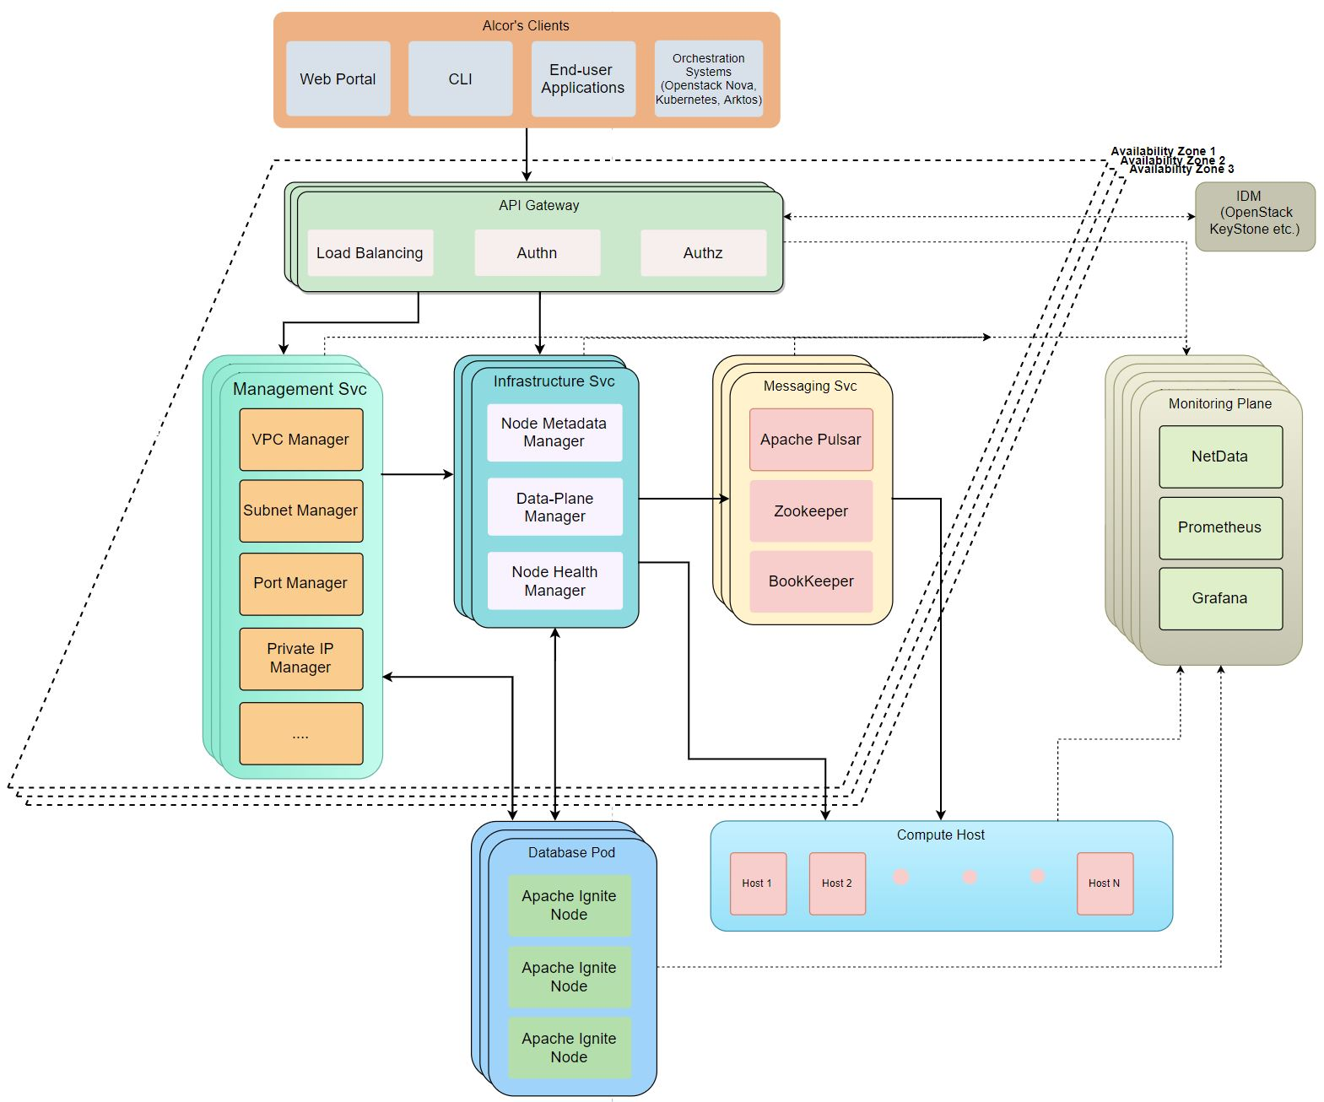
Alcor Architecture
Cloud-native architecture designed from the ground up
Fast resource provisioning
Throughput-optimal design
Multiple control paths for high availability and high reliability
Alcor performance goal
10x Latency
100x Throughput
1000x Scalability

Slide 4

Alcor Controller Innovation
Hyper-scale to support million of servers
18 microservices, each managing its own resource and scaling independently with its own DB (Ignite)
Horizontal scale-out for 1000x scalability
Decoupled resource management with in-memory DB
Ultra-Low Latency to enable new container/ serverless workload
Top-down push model for 10x latency gain (compared with bottom-up of Neutron)
Direct gRPC channel from controller to host agent for ultra-low latency
High throughput
Batch and parallel network port provisioning for 100x throughput gain
Extensive resource batching in messaging

Slide 5
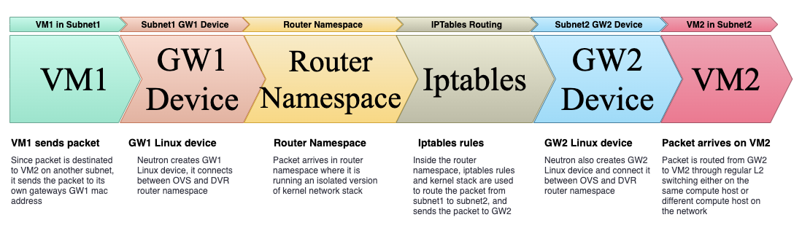
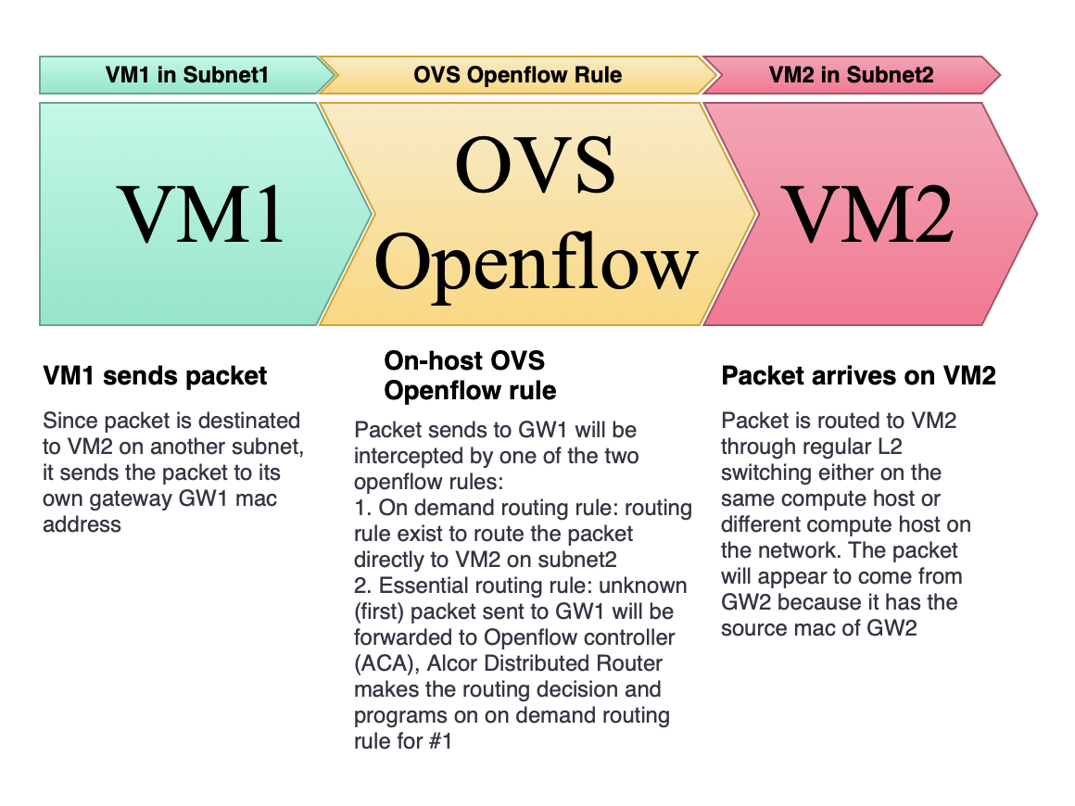
Alcor Agent Innovation
Neutron DVR packet flow
Built from the ground up with C++
Promote high performance and multiple threading
Alcor Distributed Router
Enable host-to-host direct communication for L3 routing
Use highly efficient OpenFlow rules
Eliminate namespace, Linux devices, and iptables required by Neutron DVR
On-host distributed DHCP
Proactively plumb DHCP OVS rules to compute nodes
Use local DHCP server to respond to DHCP request (compared with Neutron’s centralized DHCP server on network nodes)
Eliminate namespace, Linux devices, and Dnsmasq process required by Neutron DHCP
Alcor Distributed Router packet flow

Slide 6
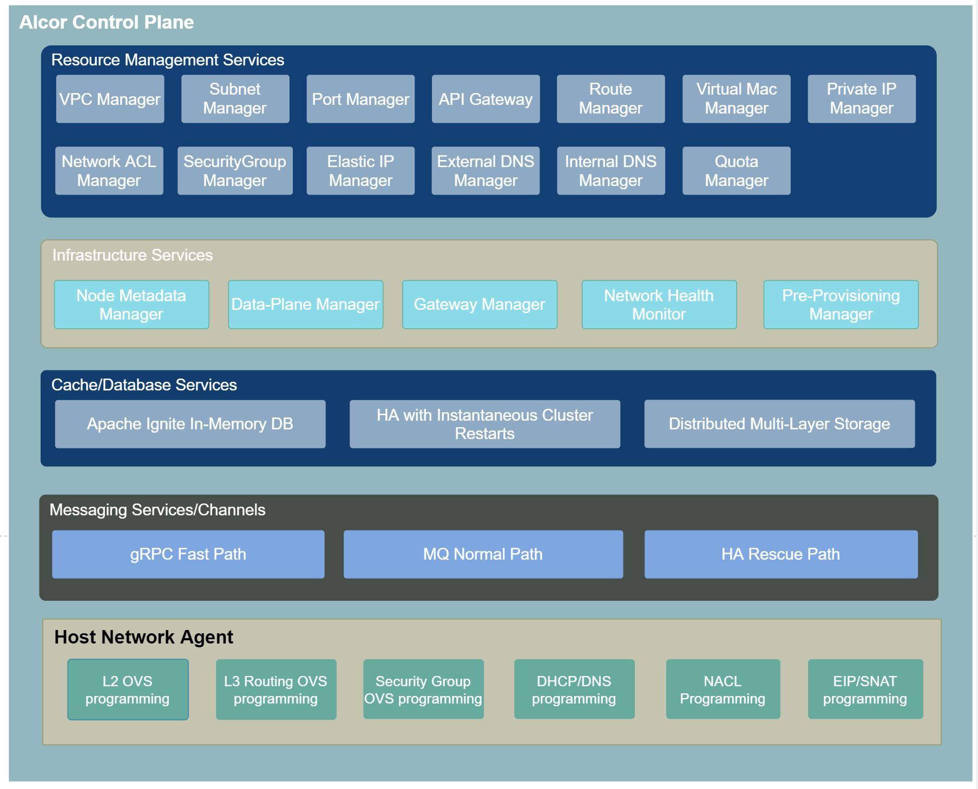
Alcor Component Snapshot

Slide 7
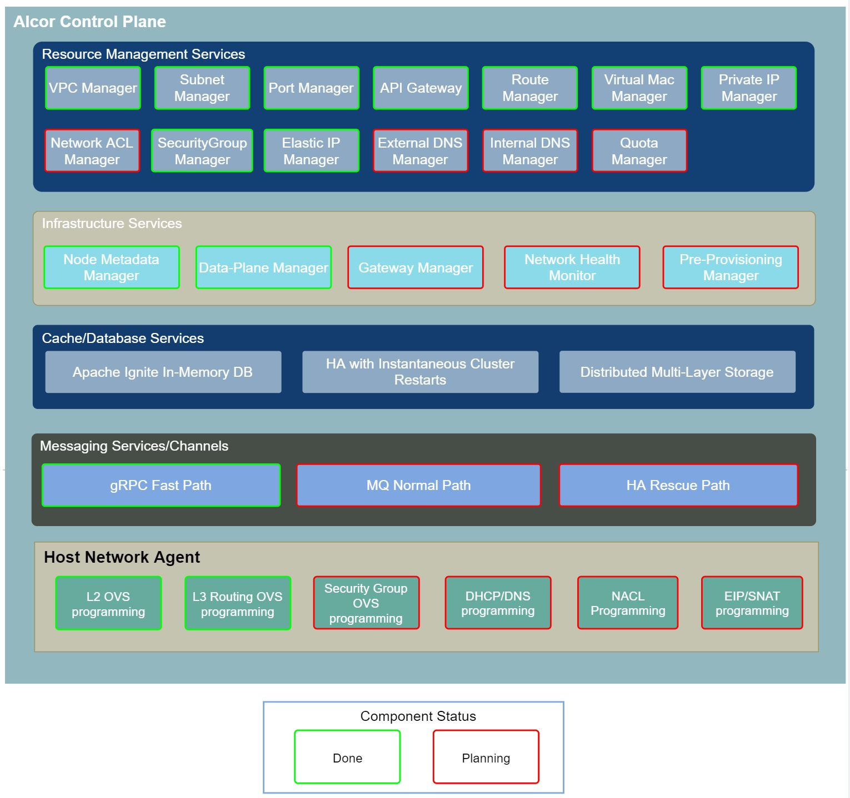
Alcor Development Status
11 microservices delivered
gRPC fast path enabled
E2E integrated with OpenStack Nova, KeyStone, Horizon UI and CLI
Preliminary performance compared with Neutron including E2E booting VM and attaching ports
Migration plan from Neutron to Alcor is ready
08/30 Release: https://github.com/futurewei-cloud/alcor/releases/tag/v0.8-alpha

Slide 8
Alcor Goal on Performance & Scalability
10x latency 1/10 Latency of Neutron
100x Throughput Provisioning 100,000 ports/min
1000x Scalability Support 1,000,000 physical servers

Slide 9
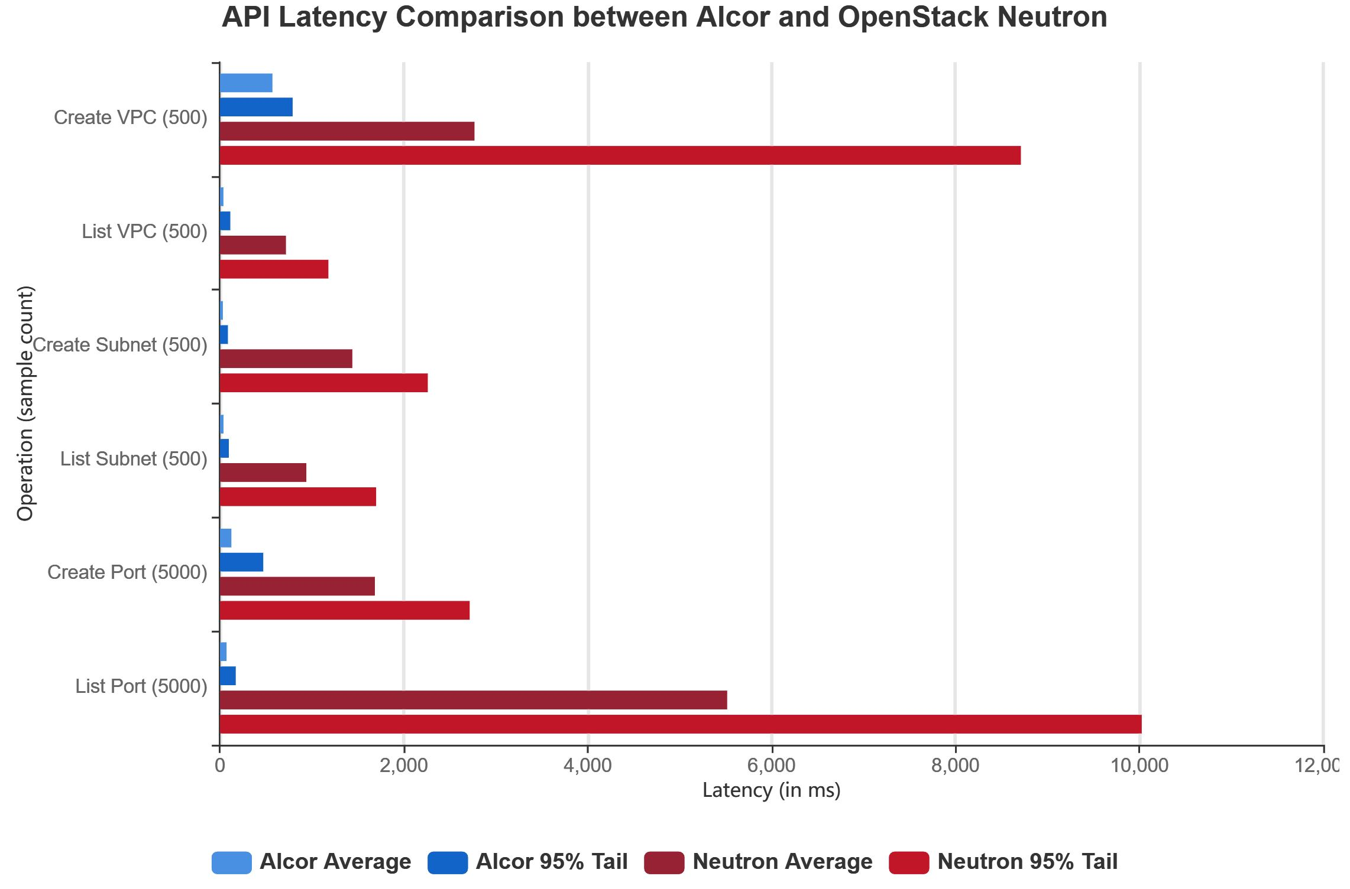
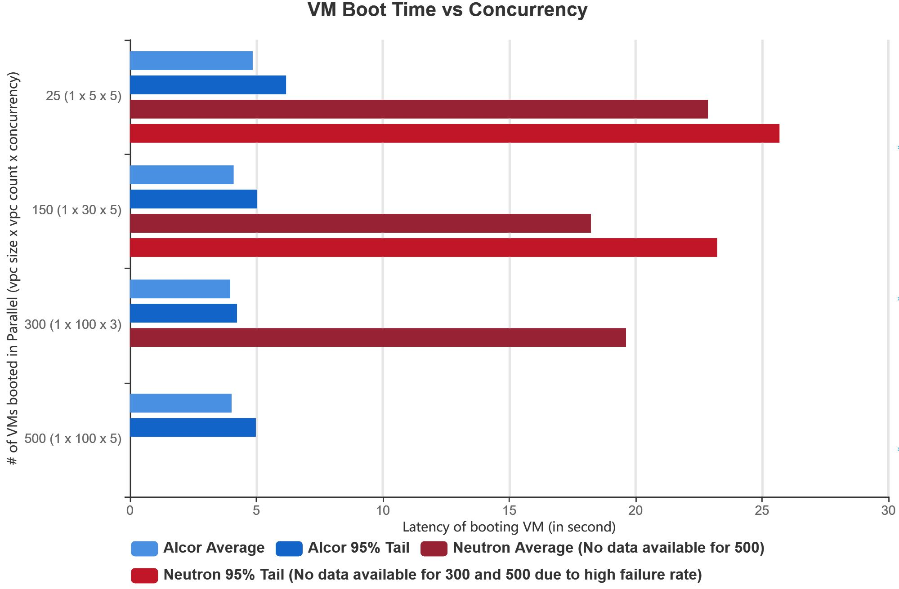
Latency Comparison
Cut 90% of Neutron latency
Reduce 75% of VM boot time and beyond
Note: Most of the Alcor REST API latency is under 200 ms due to decoupled resource modeling and distributed management with utilization of in-memory database.
Note: Neutron+Nova only reaches 23% success rate when concurrent VMs = 300 and drops to almost zero when concurrency increases to 500.

Slide 10
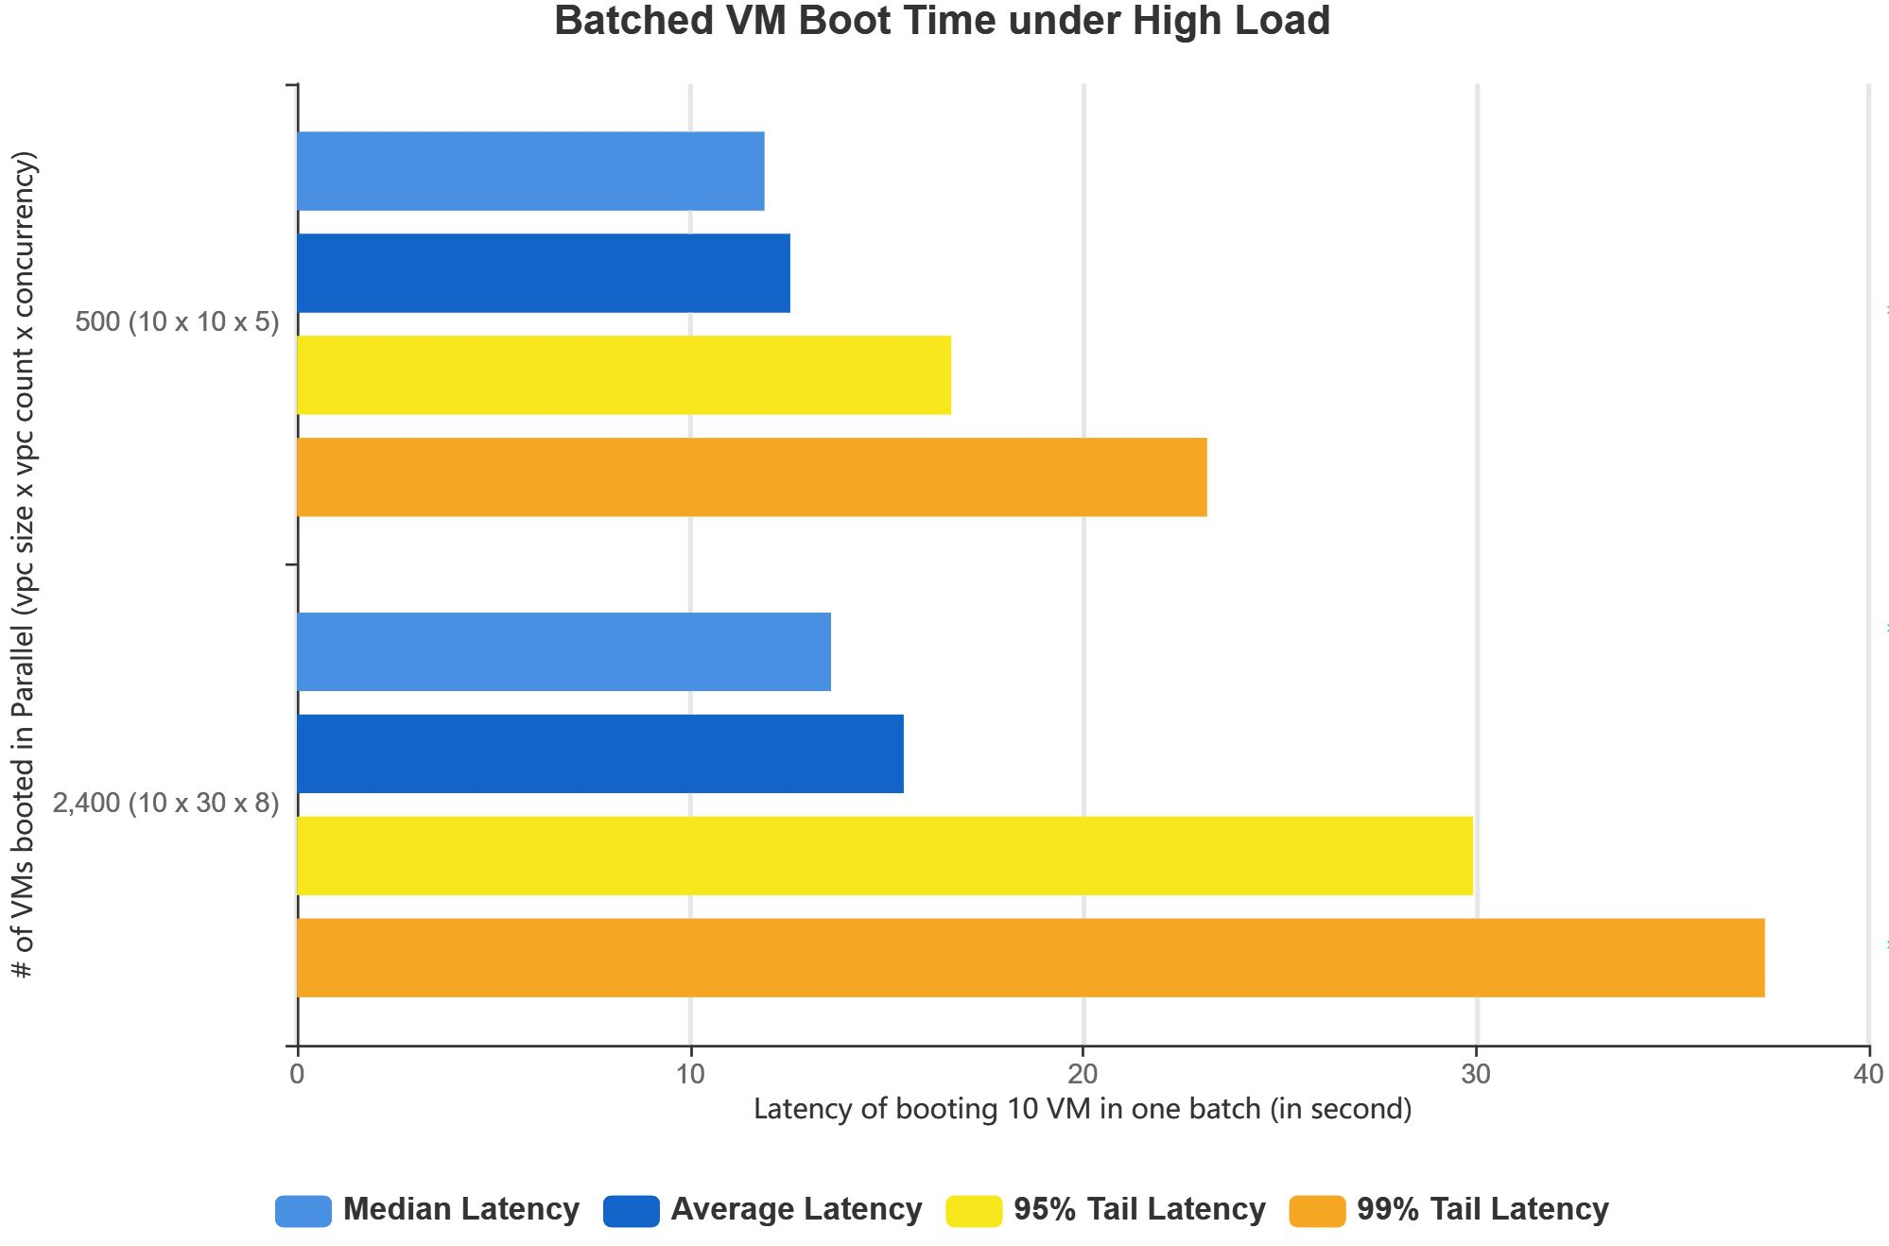
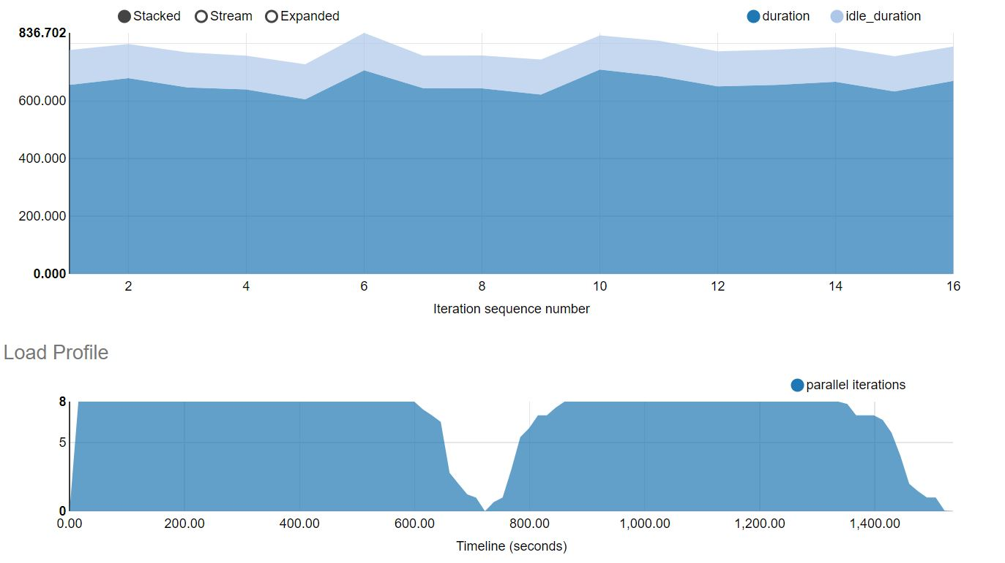
Sustainability under High Load
Support 2,400 VMs deployed in parallel to 19 compute nodes without performance degradation
Note: (1) The measured time is to boot one batch of 10 VMs, not a single VM.
(2) 2,400 VMs concurrent creation is a limit of compute capacity. Alcor not yet reached its throughput limit.
We are adding more compute capacity to find out Alcor throughput limit.

Slide 11
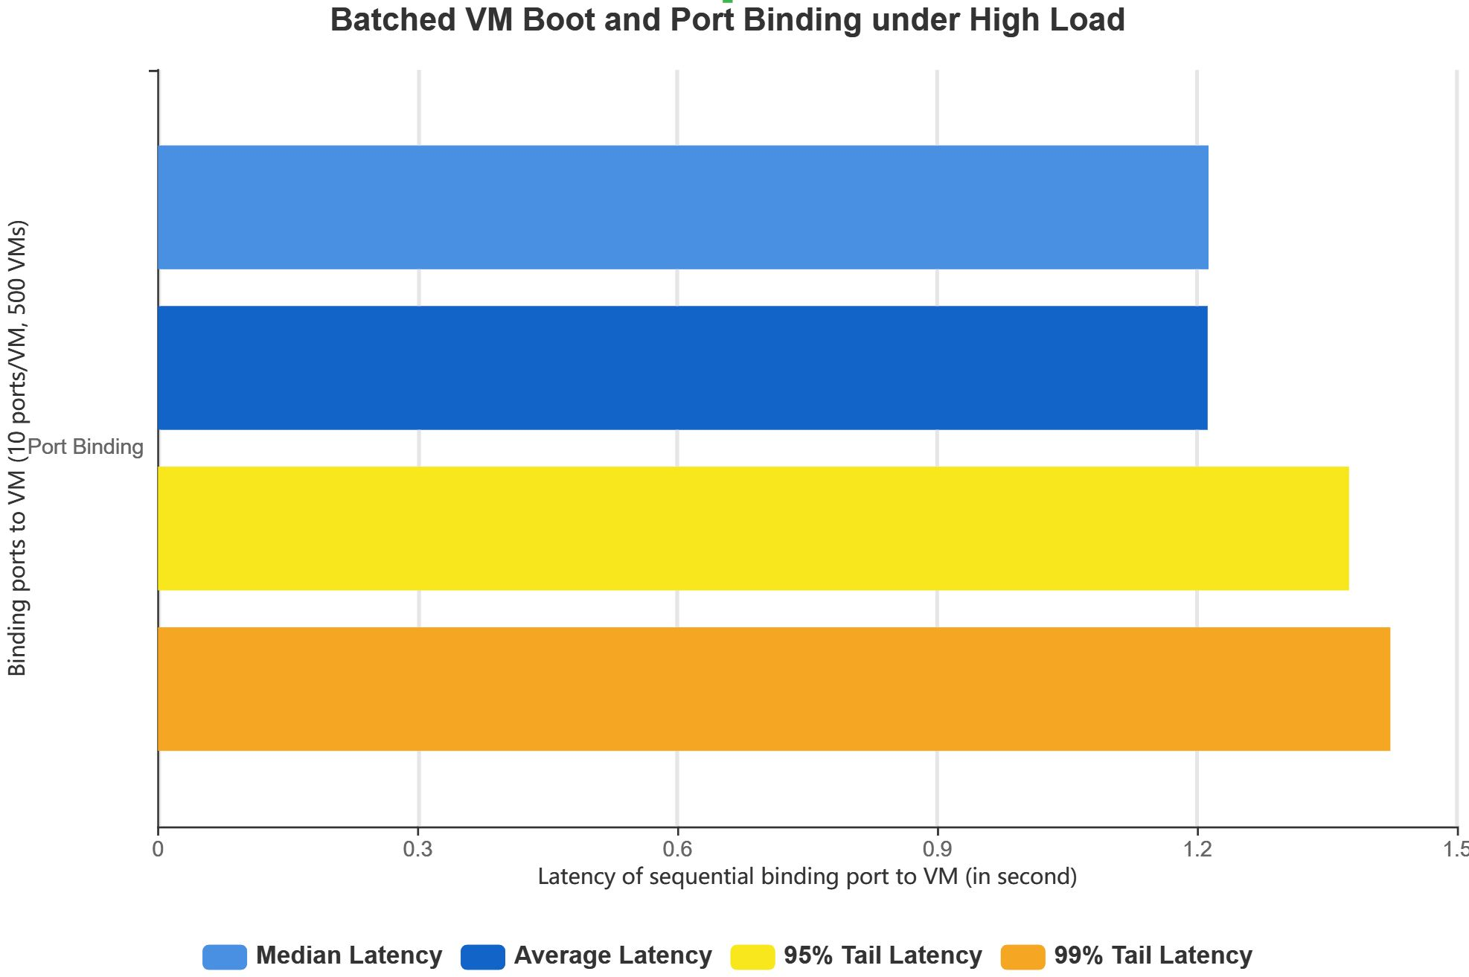
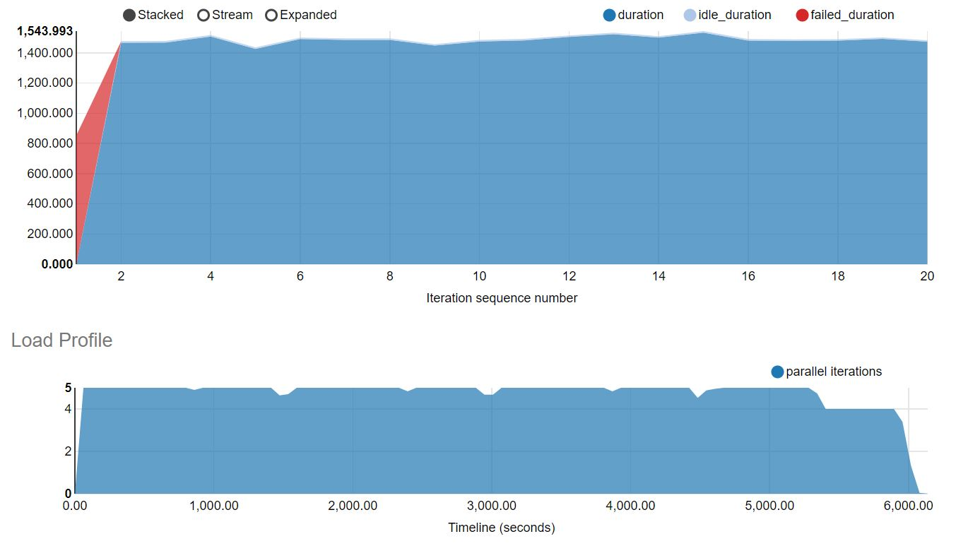
Sustainability under High Load (cont’d)
Deploy 500 VMs in parallel to 19 compute nodes and attach 10 ports to each VM, accumulated number of 5,000 ports in a batch

Slide 12
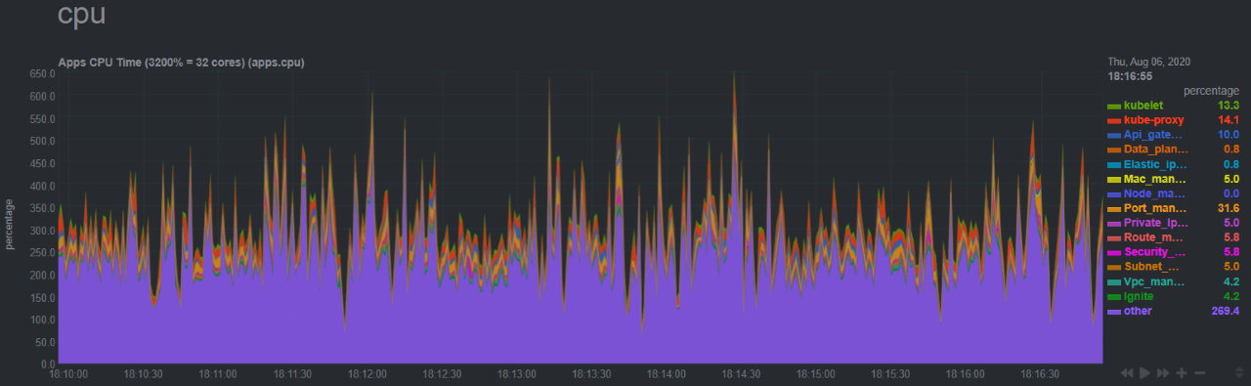
Alcor Monitoring
Enables metric collection to monitor control plane resource utilization
Monitor at various levels, from container pod, to microservice and to a host
Zoom into every microservice pod and infra pod
Include comprehensive metrics like cpu, ram, io, and network etc.

Slide 13
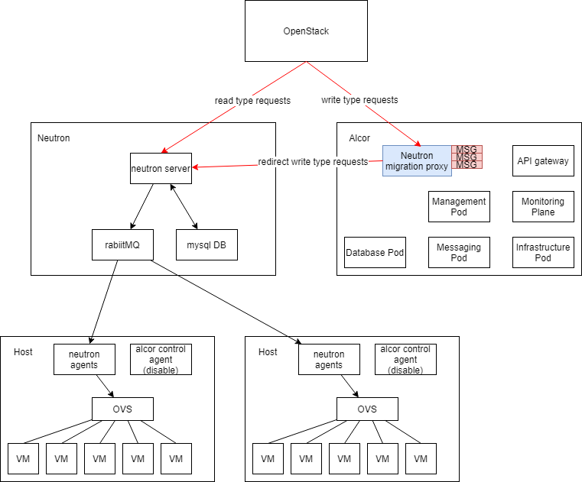
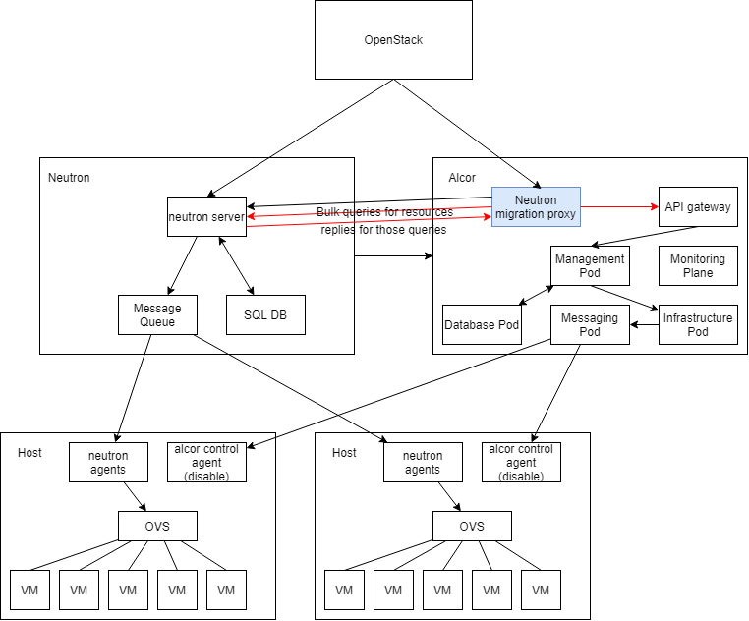
Migration Plan from Neutron
Step 1: Active Neutron and passive Alcor with request caching
Step 2: Proactive request processing by Alcor

Slide 14
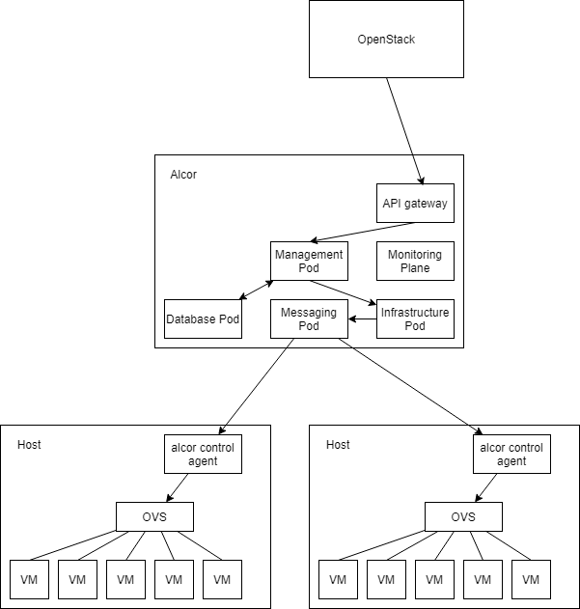
Migration Plan from Neutron (cont’d)
Step 3: Seamelss Transition to Active Alcor
Link: https://github.com/futurewei-cloud/alcor/blob/master/docs/modules/ROOT/pages/deploy_related/deployment.adoc

Slide 15
Planning for Second Half of 2020
Focus 1: Conduct 1M node scalability testing and verify Alcor scalability
Collaborating with 创新部
Focus 2: Feature enrichment, and enable E2E for L3 Routing, Security Group, NACL, and EIP
Collaborating with 创新部, 架构部
Focus 3: Alcor large-scale network resource distribution and programming
Target: Support large VPC scaled to 100,000 ports
Collaborating with 创新部, 中科大

Slide 16
Design docs are available here
Questions later?
Feel free to send email to lxie@futurewei.com or raise questions on Alcor Slack Channel

